Slide 1
dbatools for the Uninitiated
You’ve just inherited a large SQL Server estate, and next month’s merger will double the number of instances you’re responsible for. Or maybe you have one big instance with thousands of databases on it. Are there backups? Are they good? Are your systems in good health?
The department just decided to reorganize and consolidate databases to prepare for an upgrade to the next release of SQL Server. How are you going to manage all this?
It's time to automate with the dbatools Powershell module. We’ll briefly talk about the project itself, then take a tour of functions commonly used to manage SQL Server environments and data. When you leave, you’ll be ready to level up your administration toolkit and start reducing your daily workload.

Slide 2
Dbatools for the Uninitiated
Notes:
How many use PowerShell?
Used sqlps, sqlserver or dbatools modules?
How many instances do you manage?
Any scripting?
Ever automated daily tasks?

Slide 3
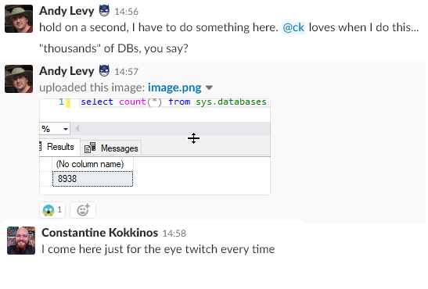
Where I’m Coming From
Former Developer
Let’s code our way through
Notes:
When I started my job, I was floored by the number of databases. How do you do backups? When and how can you perform checkdb? How does anything work at this scale?

Slide 4
Agenda
Advantages of Automation
History of Automation on Windows
PowerShell ❤ SQL Server
Demos
Notes:
Since 1999
Visit & thank sponsors & volunteers

Slide 5
Who am I?
Web Developer/Web Server Admin
Systems Integrator
Development DBA
Production DBA
dbatools Contributor
User Group Leader
SQL Saturday Organizer
Notes:
Since 1999
Visit & thank sponsors & volunteers

Slide 6
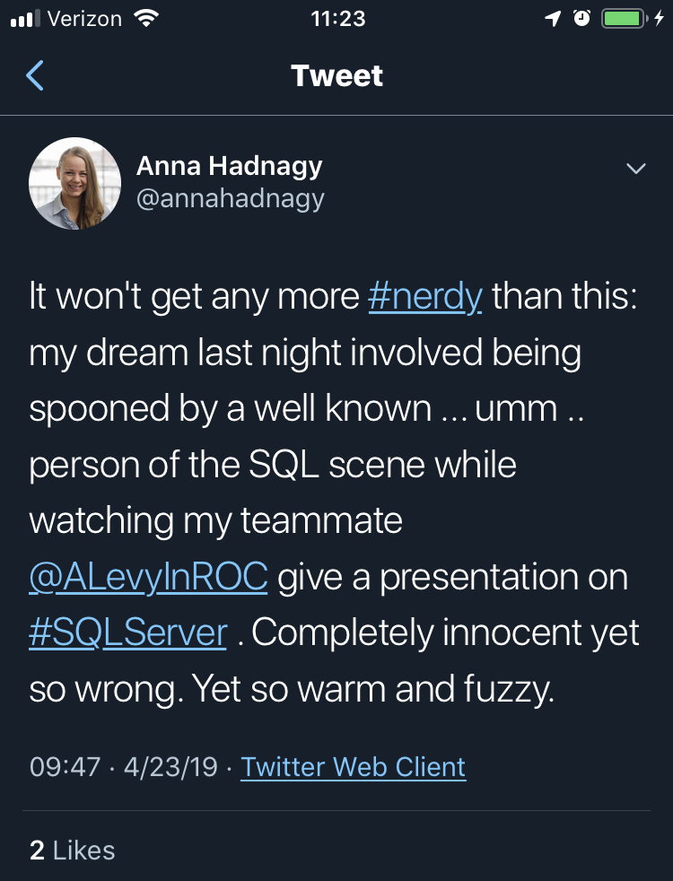
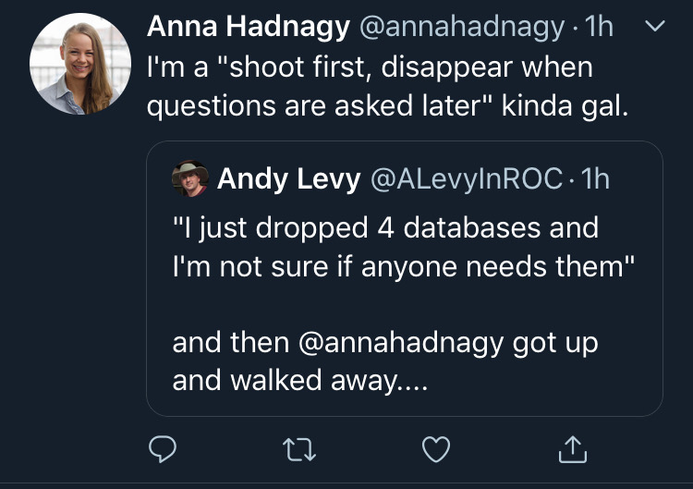
Who Am I?
Notes:
8K DBs - design problems get magnified at scale
She said I could!

Slide 7

NASA Goddard Space Flight Center from Greenbelt, MD, USA [Public domain]

Slide 8
Why Automate?
Documentation
Scripting is communication
Repeatable
Trackable
Scalable
Notes:
Documentation - better than Word
Documentation is a love letter to your future self
Communication – Can put powershell snippets into your ticket notes
Trackable - “You can’t put mouse clicks in source control” (Snover)

Slide 9
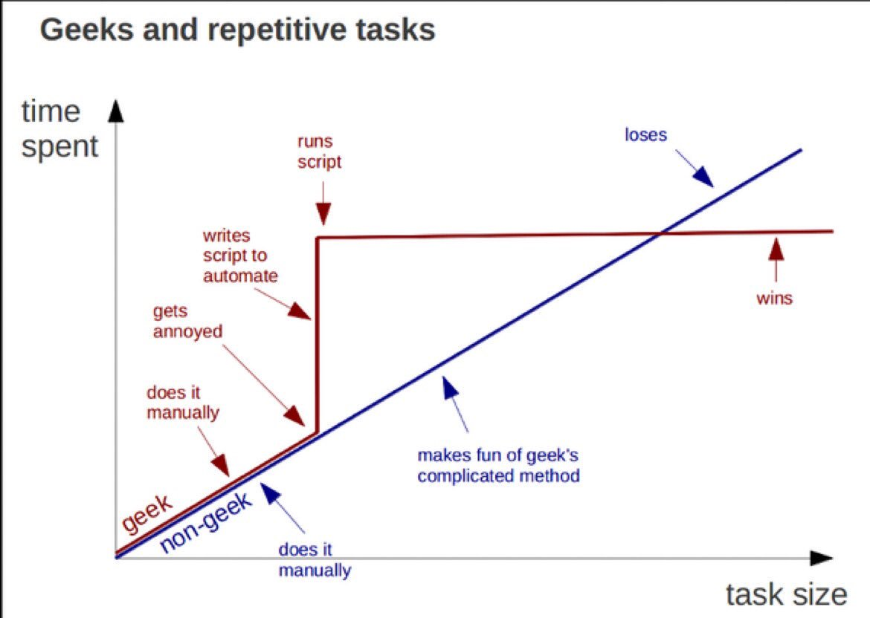
https://twitter.com/kirkdborne/status/804145411997007873

Slide 10
Microsoft & Automation
Ancient History - Batch/cmd files
The Middle Ages - Windows Scripting Host
The Renaissance (2006) - PowerShell 1.0
The Enlightenment (2016) - PowerShell Core
Notes:
Jeffrey Snover is now a Microsoft Technical Fellow

Slide 11
SQL Server & PowerShell
2008 - sqlps & PowerShell Agent Job Step
2016 - sqlserver
2017 - sqlserver in Powershell Gallery
Good starting point
Notes:
Module and cut-down version of PowerShell. Don’t use any of these
Released with SSMS 2016, then sat idle
Moved to gallery April 2017
See Drew’s session for more detail

Slide 12
Discovery
Get-Command/Find-DbaCommand
Get-Help
Get-Member
Notes:
TODO: Show Find-DbaCommand “Connect”

Slide 13
What is dbatools?
Open Source Powershell module for data professionals
BDFL Chrissy LeMaire
163 contributors
Started July 2014
1.0 on June 20, 2019
Notes:
Single purpose - now almost 550 functions

Slide 14


dbatools vs. sqlserver
Mega multitool vs. Swiss Army Knife
Breadth & depth
Release frequency
Community-driven
Notes:
Sqlserver: 107 functions
Dbatools: 558 functions

Slide 15
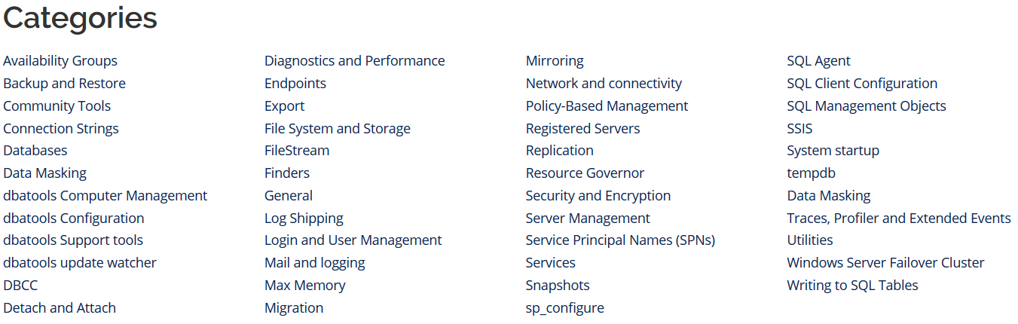
dbatools Function Categories
https://dbatools.io/commands/

Slide 16
SMO
Underpinning of Management Studio
Can be unwieldy

Slide 17


Slide 18


Slide 19
Contributing
Issues
Feature Requests
Documentation
Slack!
Code!

Slide 20
wrap-up
https://dbatools.io/
Check dbatools for a solution first
Safety first! Use –whatif and -verbose

Slide 21





Where to Find Me
https://flxsql.com/
andy@flxsql.com
@alevyinroc

Slide 22
Backup and Restore
Install Ola solution
Restore to point in time
Snapshots

Slide 23
Instance Migrations
Copy/update configuration
Copy security
Copy Agent jobs
Copy data

Slide 24
Monitoring
First responder kit
Whoisactive
Glenn berry queries
Watch-*

Slide 25
Maintenance
Ola hallengren
Compression

Slide 26
Validation
Test last backup

Slide 27
Automation
Migration
Copy databases
Configuration

